Slide 1
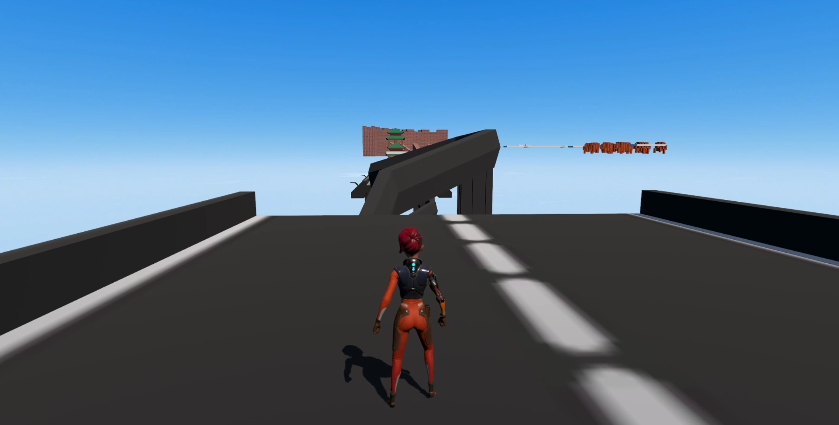
Speed Parkour
David Tsang
Blake Luo
TPS Parkour Game

Slide 2
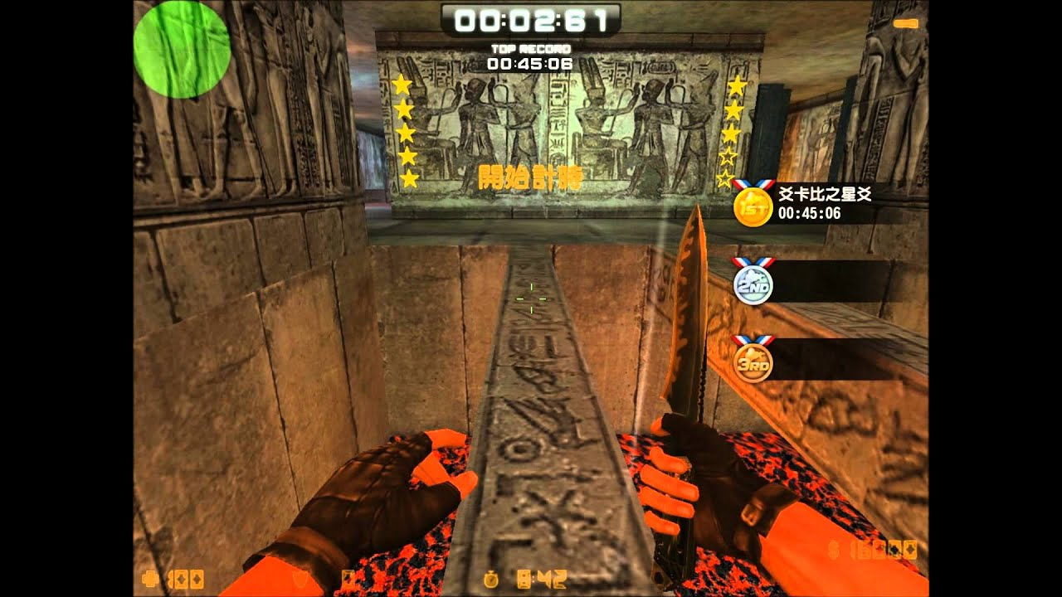
Background
A person who is starting to play parkour. the player should help him to finish the level of different terrain.

Slide 3
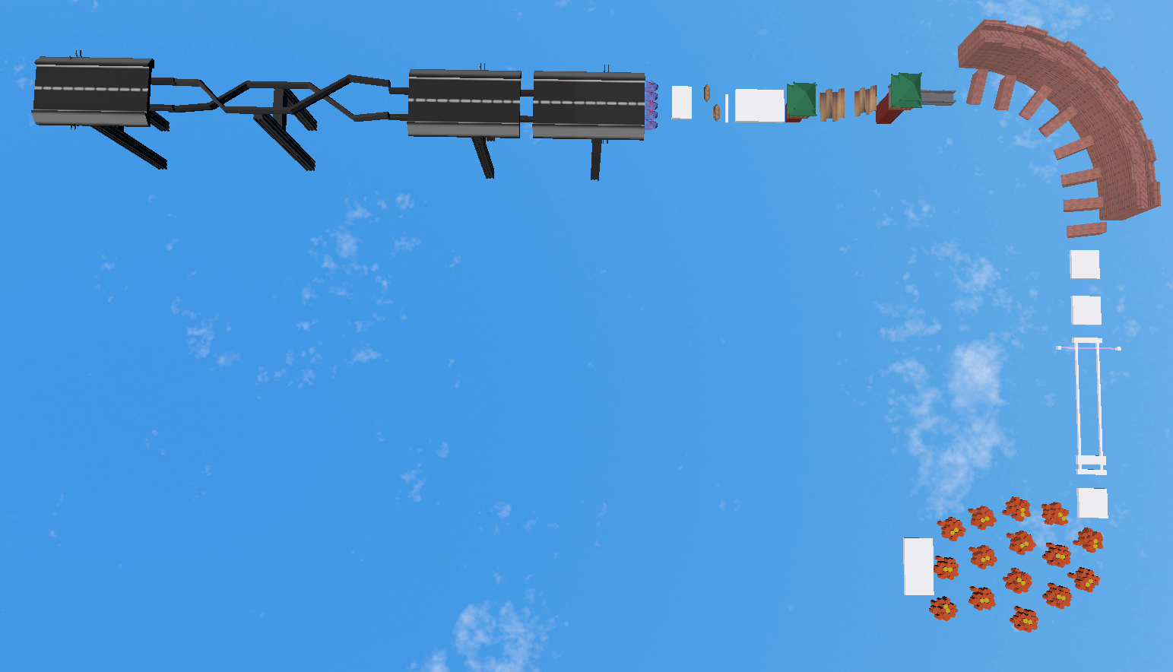
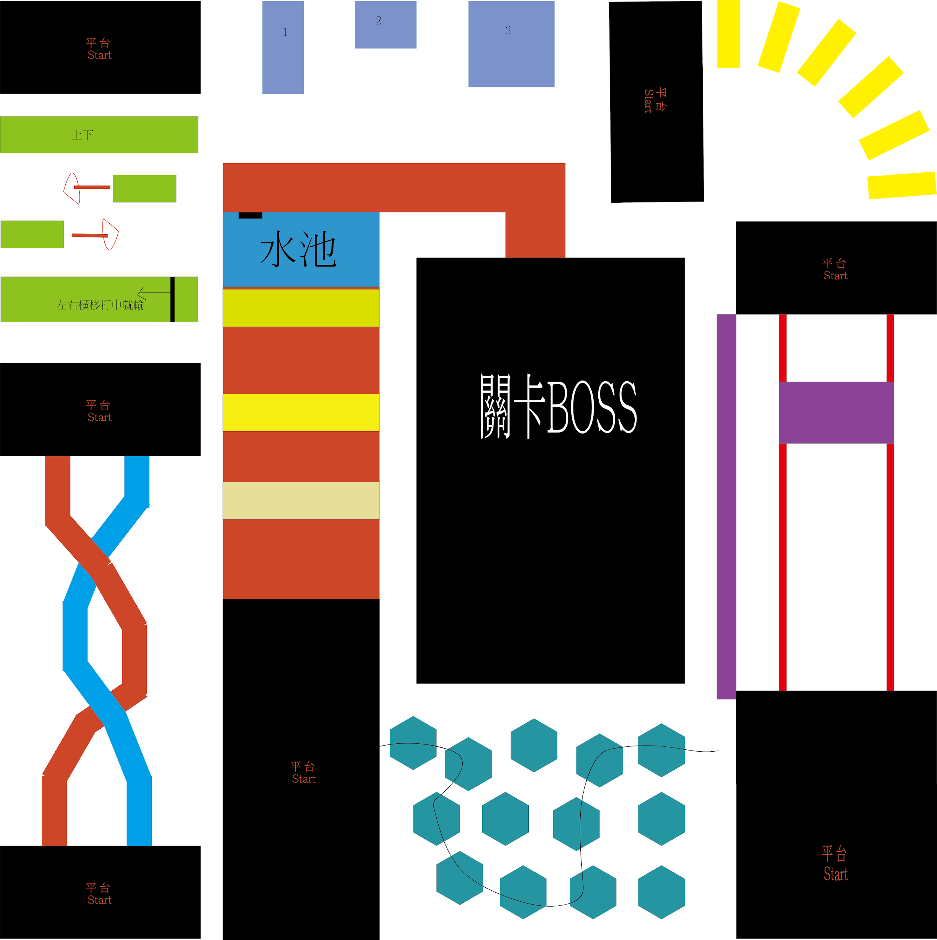
Design 1st Level

Slide 4
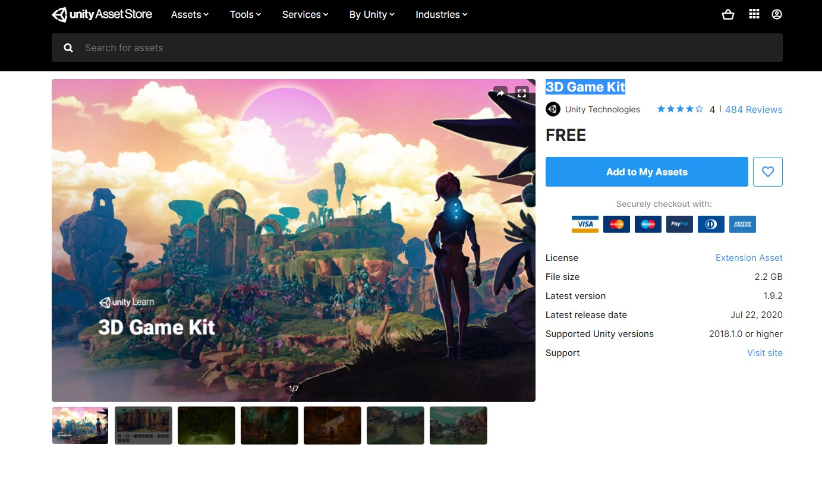
3D assets
All 3D assets are created by Blender
Assets from asset store
3D Game Kit
SkyBox

Slide 5
Game Play

Slide 6
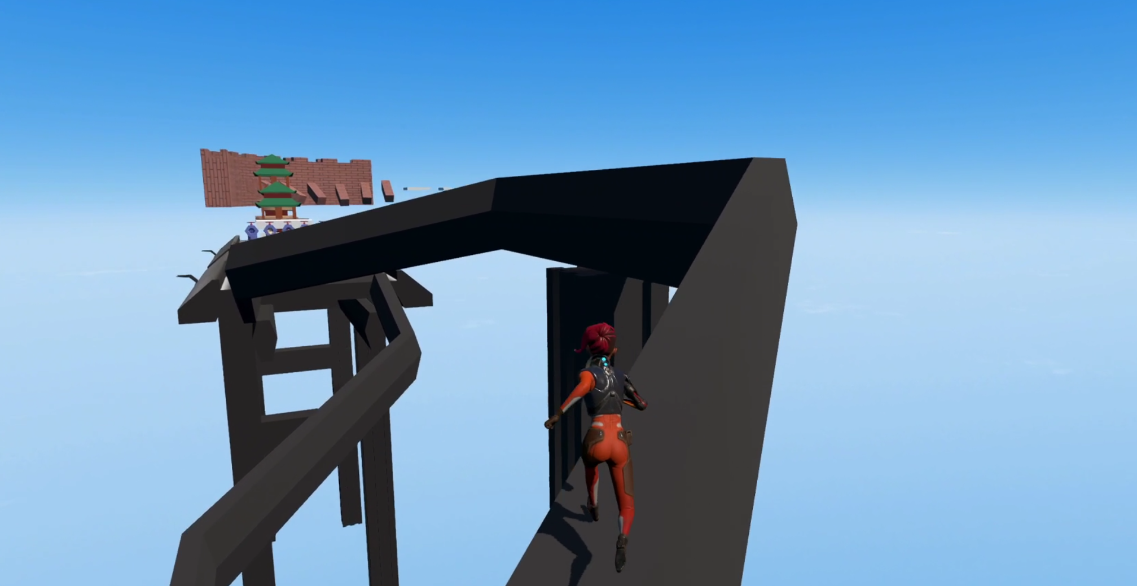
Start - Tube

Slide 7
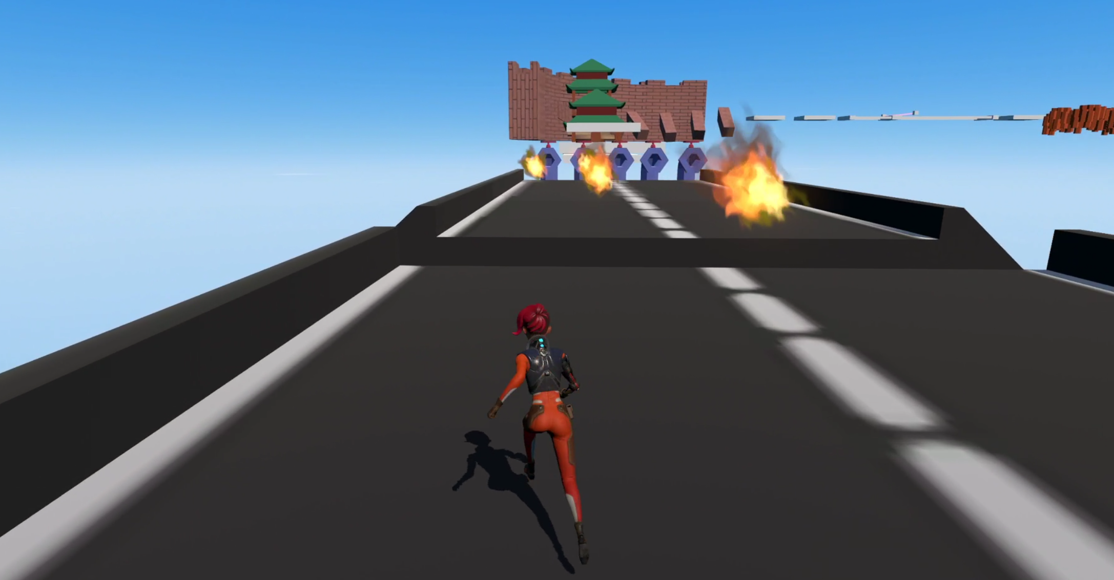
Tube - Fire

Slide 8
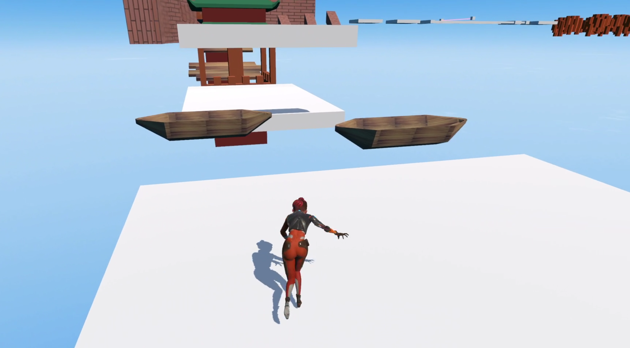
Wood Ship

Slide 9
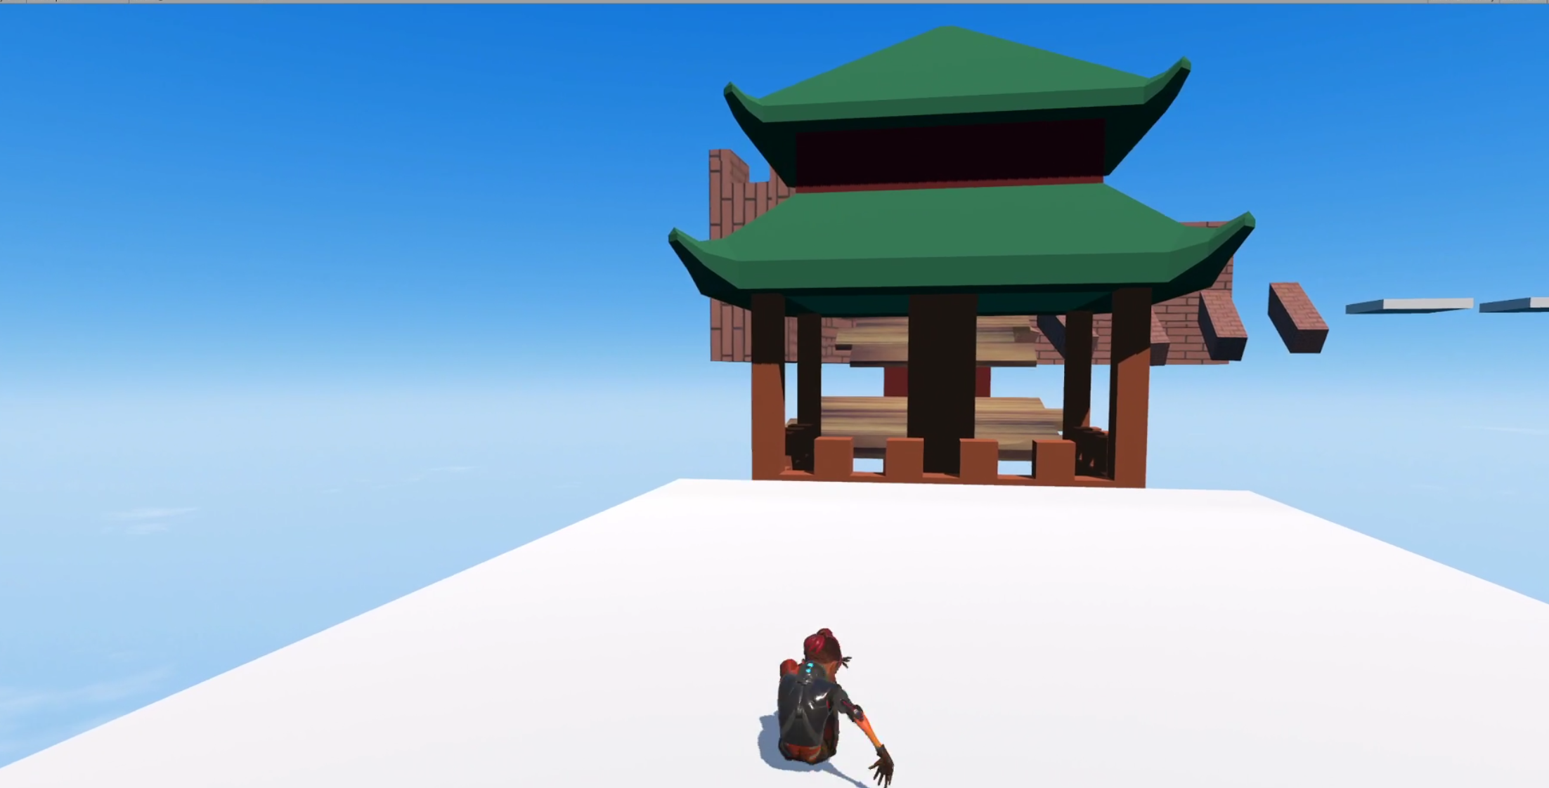
China - Bridge

Slide 10
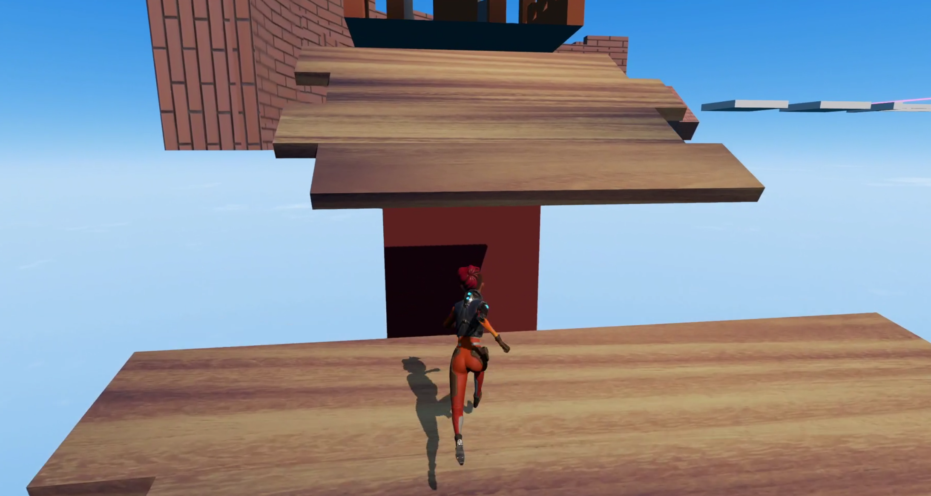
China - Bridge

Slide 11
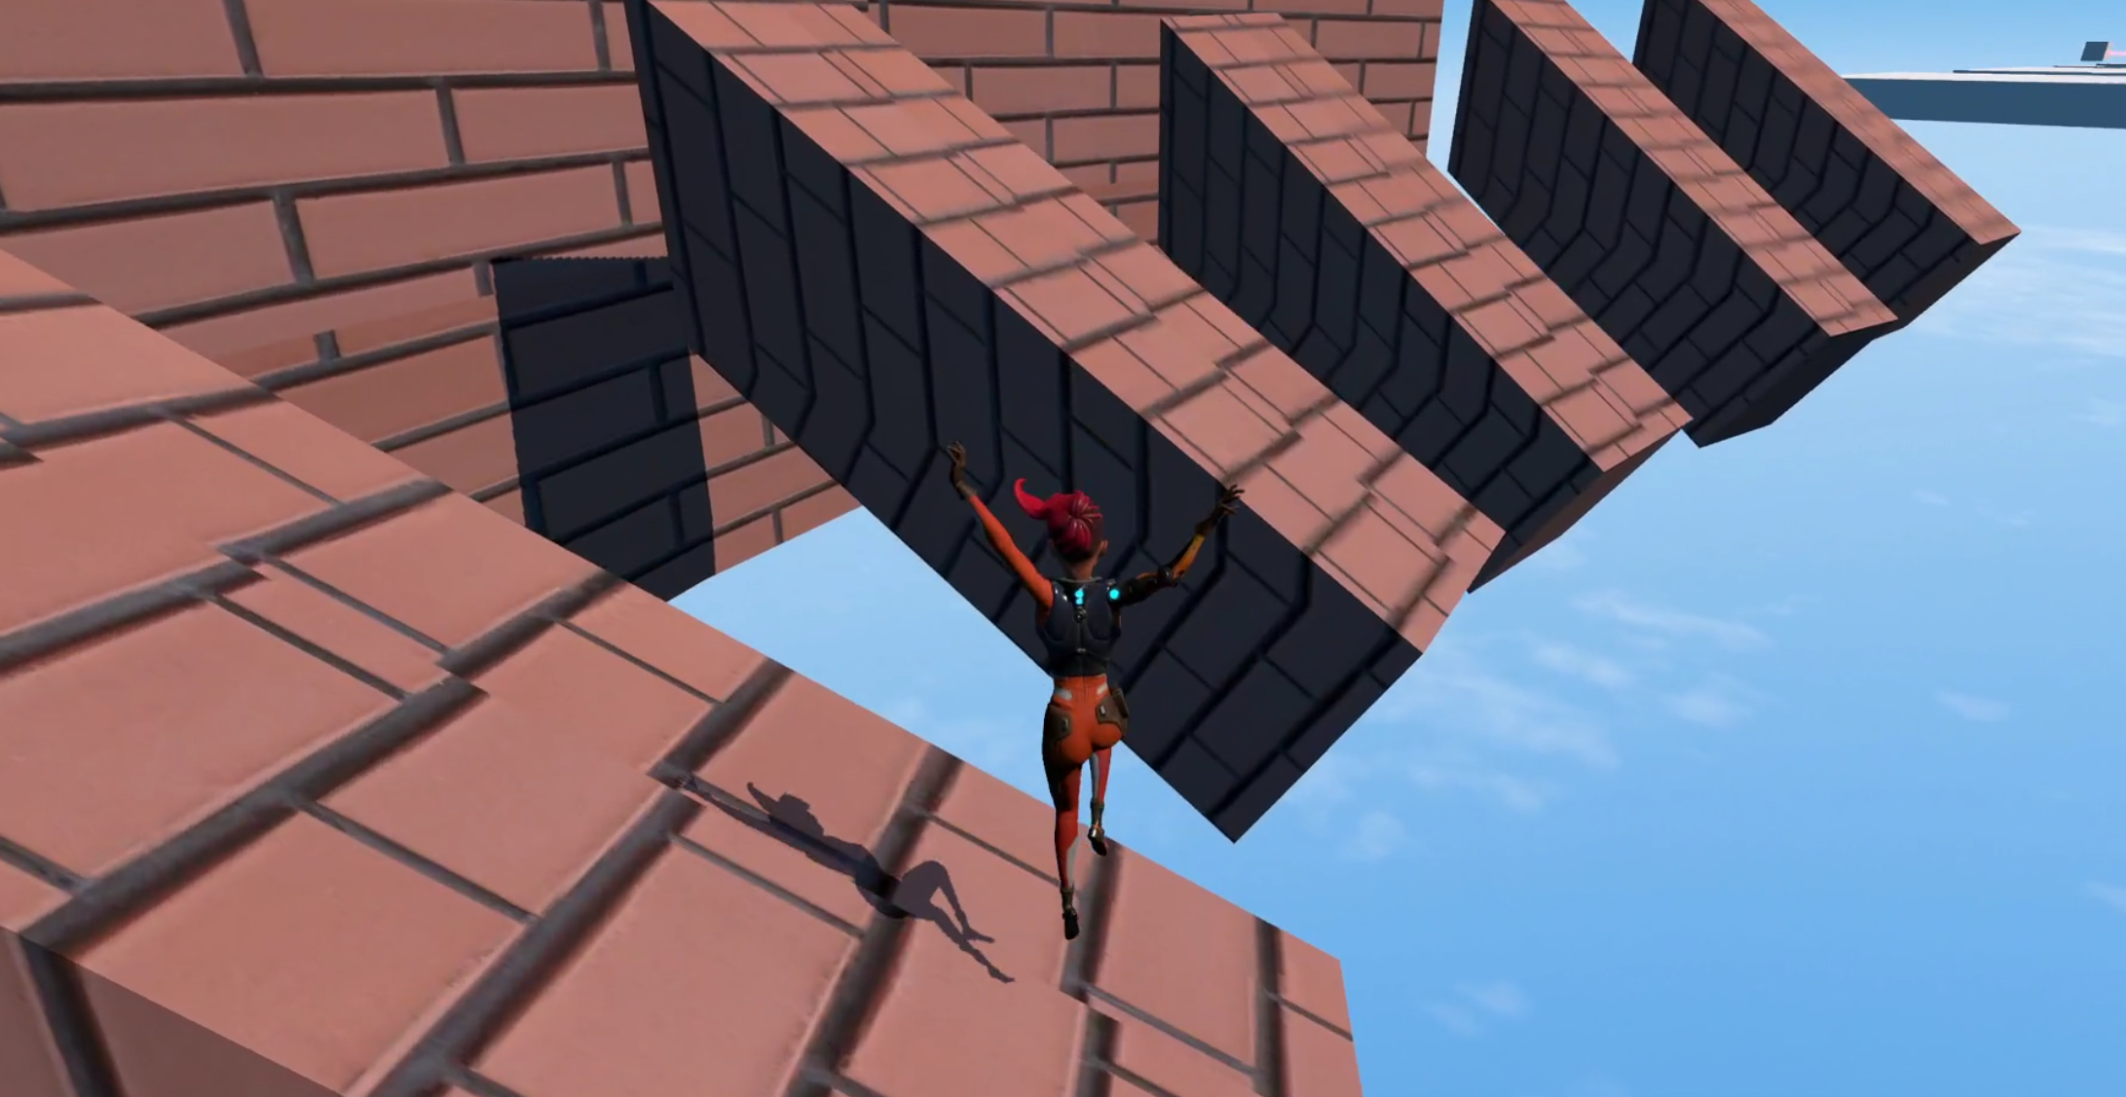
Great Wall

Slide 12
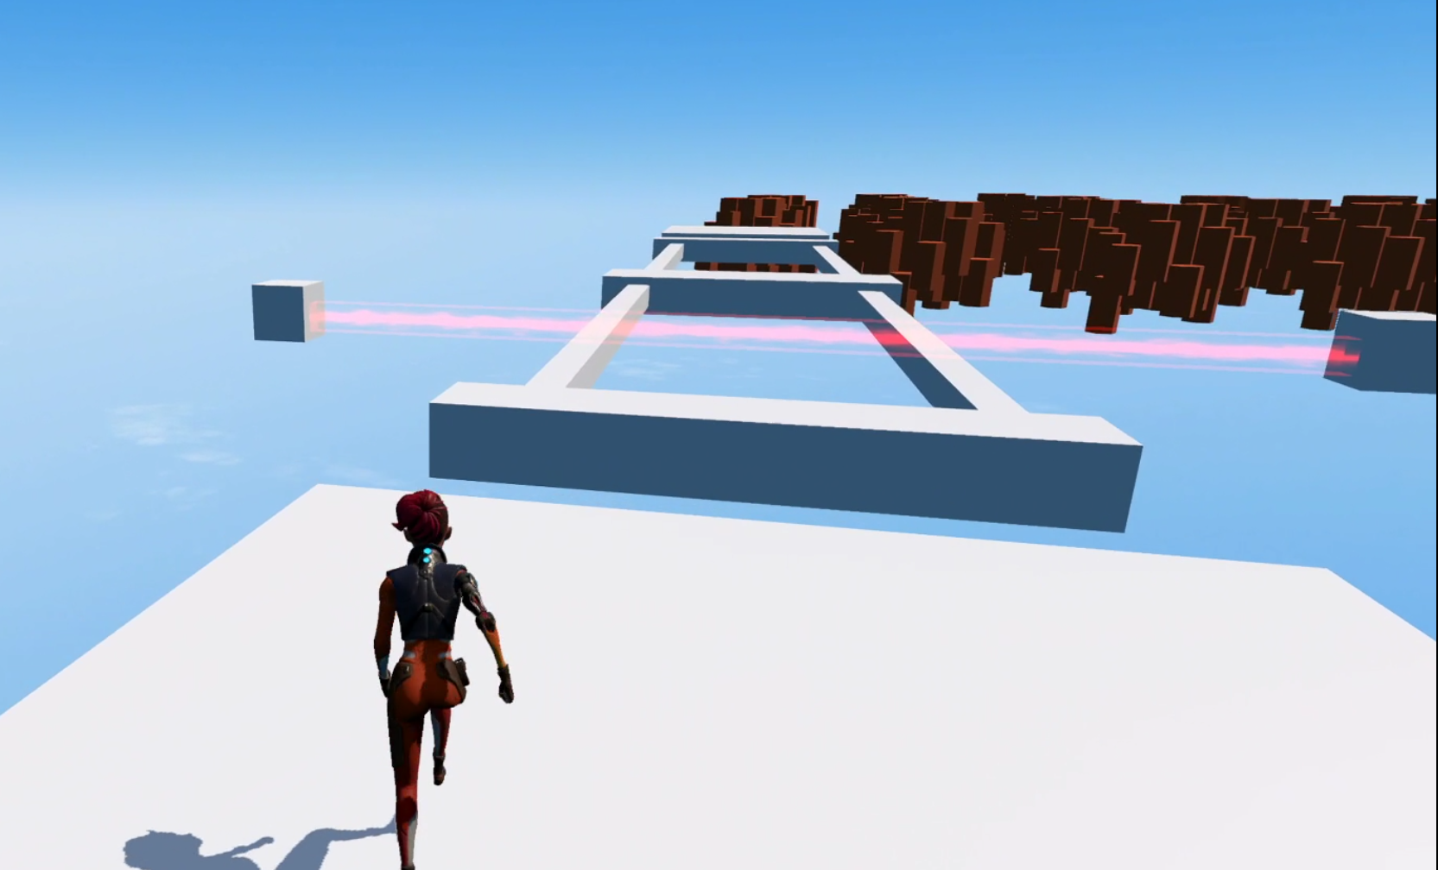
Laser

Slide 13
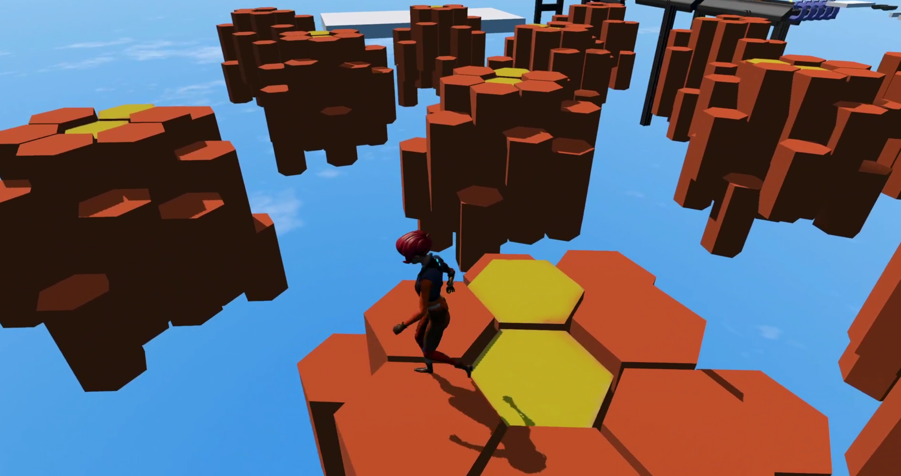
Floating Stone formation

Slide 14
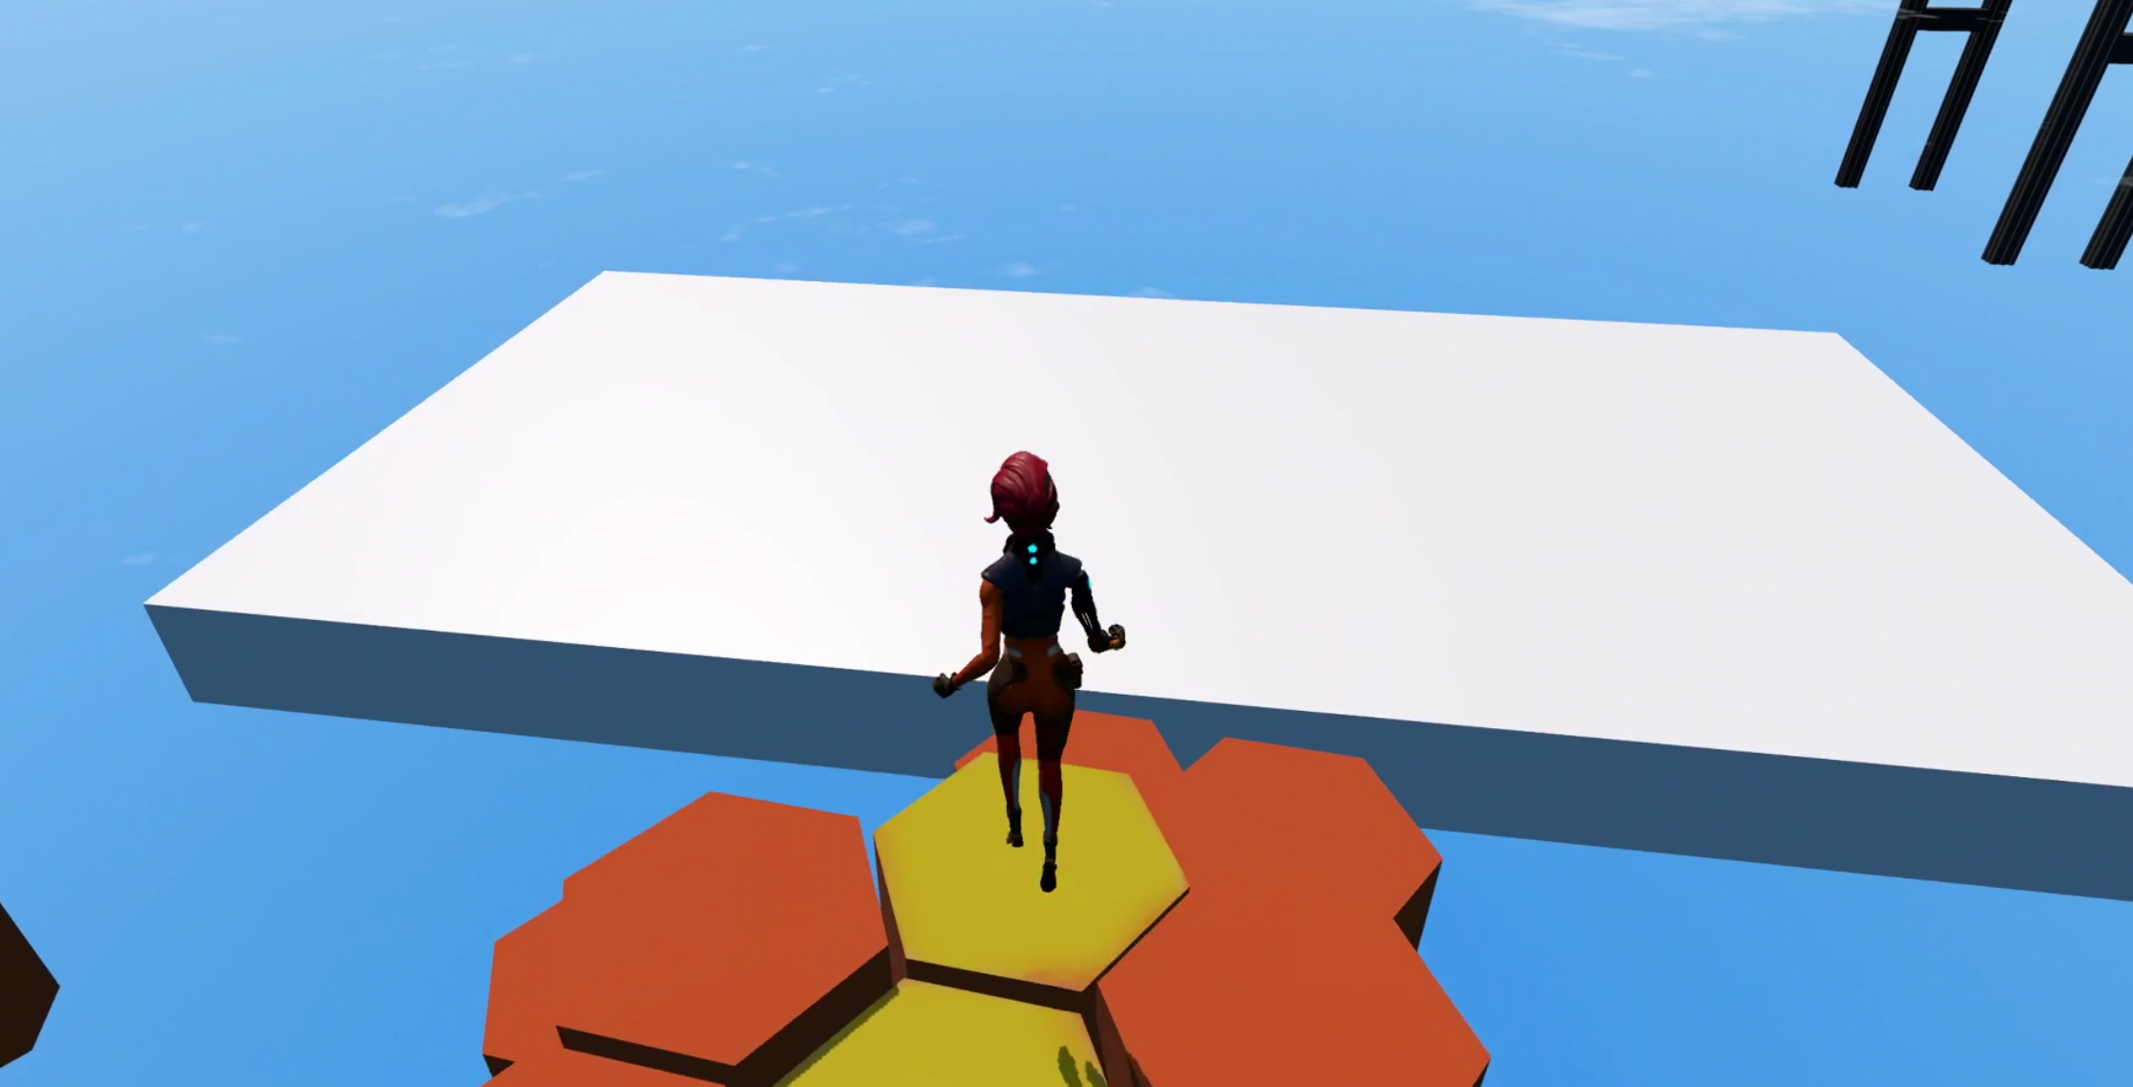
End (to next level - TBD)

Slide 15
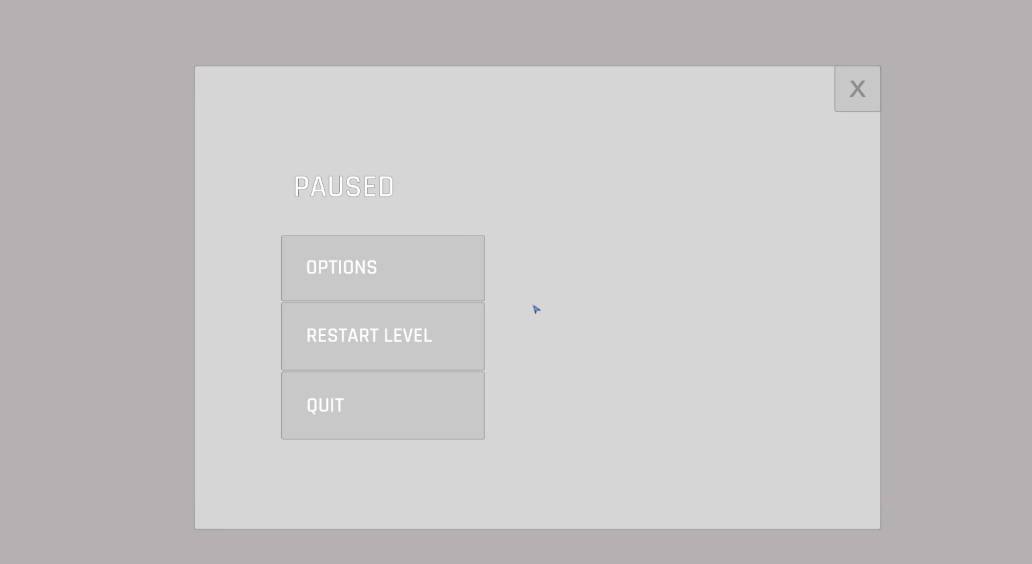
Menu

Slide 16
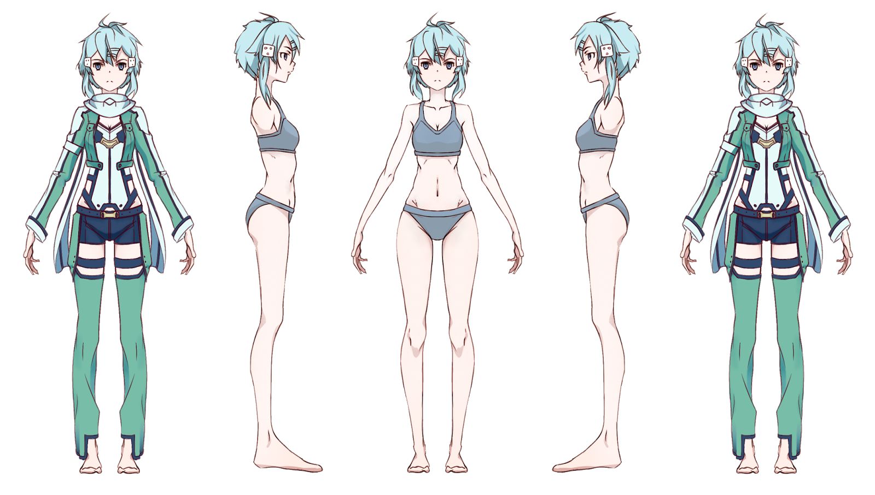
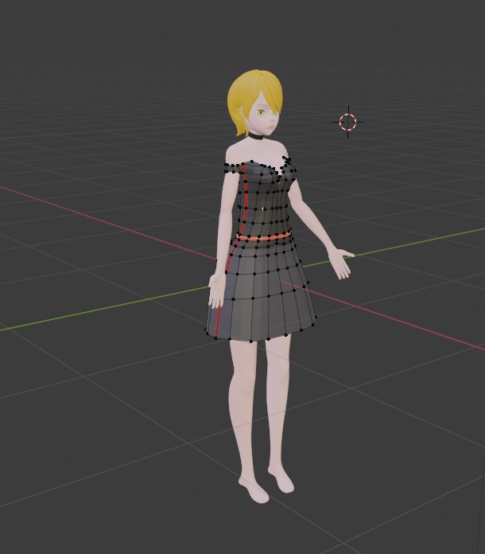
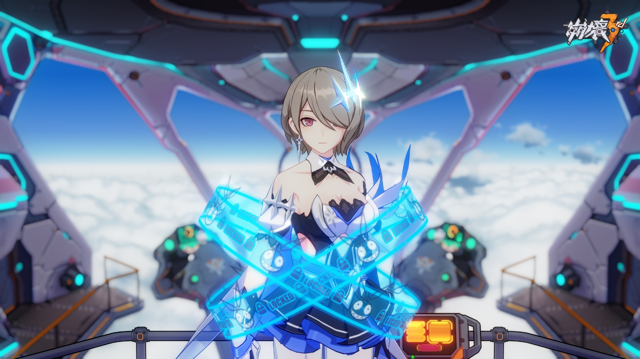
Character Model Reference

Slide 17
Coming Soon
New character model
One more harder levels
Terrain UPDATE(More Exterior Design)

